Slide 1

Data Communication & Networks
Spring-2021
(Week-5)
Course Teachers: Mr. Waleej Haider (Asst. Prof),
Ms. Razia Nisar Noorani (Asst. Prof)
Department of Computer Science & Information Technology

Slide 2
Data Transmission

Slide 3
Transmission Impairments
Signals travel through transmission media, which are not perfect
Thus signal received may differ from signal transmitted causing:
  For analog signals - degradation of signal quality
  For digital signals - bit errors (1becomes 0 or 0 becomes1)
Called Transmission Impairments
Most significant impairments are
  Attenuation (weak signals)
  Delay distortion (delay due to distortion)
  Jitters (variation in delay)
  Noise (unwanted signals)

Slide 4
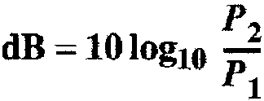
Attenuation
When signal strength falls off with distance due to medium imperfection is called Attenuation
received signal strength must be:
  strong enough to be detected
  sufficiently higher than noise to be received without error
Solution: Strength can be increased using amplifiers/repeaters
To show that a signal has lost or gained strength, engineers use the unit of the decibel.
The decibel (dB) measures the relative strengths of two signals or one signal at two different points (P₁ & P₂).
Note that the decibel is negative if a signal is attenuated and positive if a signal is amplified.

Slide 5
Delay Distortion or Distortion
Distortion means the signal changes its form or shape
Distortion can occur in a composite signal made of different frequencies.
Each signal component has its own propagation speed through a medium
Hence various components arrive at the receiver at different times
Resulting in phase shifts between the different frequencies if the received signal is distorted due to varying delays experienced at its component frequencies
Differences in delay may create a difference in phase if the delay is not exactly the same as the period duration.

Slide 6
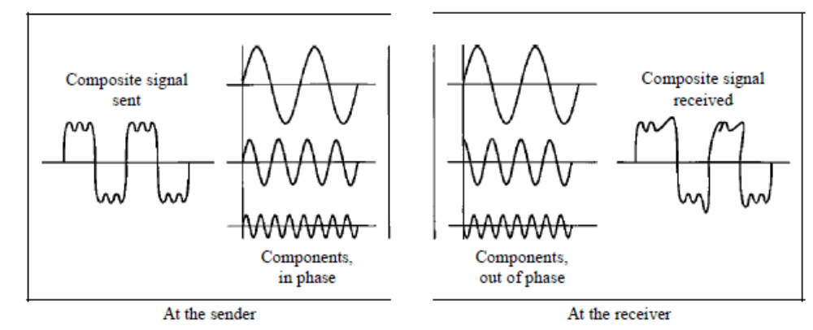
Cont..
The shape of the composite signal is therefore not the same. (See Figure)
It only occurs in guided media
It is particularly critical for digital data
Because some signal components of one bit position will run over into other bit positions, causing inter-symbol interference

Slide 7
Jitters
Due to variation in phase delay
We can roughly say that jitter is a problem if different packets of data encounter different delays and the application using the data at the receiver site is time-sensitive (audio and video data)
For example, If the delay for the first packet is 20 ms, for the second is 45 ms, and for the third is 40 ms, then the real-time application that uses the packets suffers jitter
Attenuation, distortion and the modulation of the telephone channel causes variation in the propagation delay at any single signal
This is known as Jitter.

Slide 8
Noise
Additional undesired signals added between transmitter and receiver
Thermal noise
  Due to random motion of electrons in a wire which creates an extra signal
  It is a function of temperature
  Uniformly distributed across the bandwidth
  Present in all electronic devices and transmission media
  Also called white noise
  Particularly significant for satellite communication

Slide 9
Noise
Intermodulation noise
  When signal at different frequencies share the same transmission medium
  Produce new signals at a freq that is the sum, difference, or multiple of the two original frequencies sharing the same medium
Crosstalk noise
  Crosstalk is the interference of one wire on the other.
  A signal from one line is picked up by another
  Unwanted coupling between signal paths
  Due to electrical coupling between nearby twisted pairs

Slide 10
Noise
Impulse noise
  It is an irregular noise spike (a signal with high energy in a very short time)
  Such as short clicks and crackles with no loss of intelligibility
  Due to the fault in system, external electromagnetic interference e.g; power lines, lightning, and so on
  It is of short duration and high amplitude
  A minor annoyance for analog data
  But a major source of error in digital data
    a noise spike could corrupt many bits

Slide 11
Noise
Echo noise
  On some very long circuits, mismatching of the lines causes the signals to be reflected back to the speaker after a slight delay.
  To overcome this, echo suppressors or echo cancellers are fitted to the line so that speech is being transmitted only in one direction at a time.

Slide 12
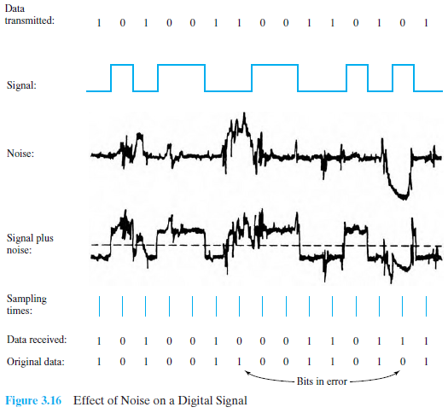
2-<number>
A. A. Waseem & Waleej Haider

Slide 13
BIT and BAUD RATES
Transmission speed is measured in terms of bits per second (BPS)
The higher the BW, the greater the data carrying capacity of a channel.
The Baud rate is the no. of distinct signals (signal elements) sent in one sec.
It indicates the no. of signal elements per second or no. of pulses per second
A signal element is represented by a change in a particular characteristic (Amplitude , frequency & phase) of a Sine wave form. Therefore , the Baud rate indicates how many changes of phase, frequency or amplitude there will be in one second.
The baud rate is sometimes called the pulse rate, the modulation rate, or the signal rate
The term “Modulation Rate” is used in preference to Baud rate when talking about modems.
Nyquist’s law states that maximum theoretical Baud or Bit rate of the telephone channel is twice the BW:
  Max. Baud Rate = 2 x Bandwidth ; or
  Max. Bit Rate = (Max. Bd) x log₂ L
    where L is the number of signal levels

Slide 14
Noiseless Channel: Nyquist Capacity
Usually bit rate (bps) and baud rate (Bd) are the same except when a baud represents more than one bit of information
For a Noise free channel the limitation on bit rate is only the BW of the signal
Nyquist’s theorem states that given a BW (W) the highest data rate that can be carried is 2W. Which means if you are using a voice grade telephone of a BW of 3000 Hz to transmit your data, then the capacity of the channel is 2W=6000 bps. (when log₂ L= 1).

Slide 15
Cont..
However if multilevel coding (modulation) is used, the capacity of the link becomes:
C= 2W log₂L
Where L= no. of discrete signals or voltage levels.
If we use 3-bit encoding scheme , 2³=8=L;and W=3000; then C = 2 (3000) (log₂8)
= 6000(3) = 18000bps
But we know that increasing the levels of a signal may reduce the reliability of the system.

Slide 16
Example:
Data is to be transmitted over the PSTN (public switched telephone network) using a transmission scheme with 16 levels per signaling element. If the BW of the PSTN is 3000 Hz, work out the Nyquist maximum data transfer rate (C)
Solution: L=16 means we use 4-bit encoding scheme and W=3000; then
C = 2 (3000) (log₂ 16)
= 6000(4) = 24000bps

Slide 17
Signal-to-Noise Ratio (SNR)
But communication channels are always affected by noise and distortions.
To find the theoretical bit rate limit, we need to know the ratio of the signal power to the noise power
If signal-to-noise ratio is:
  S/N = Average signal power / Average noise power
S/N is actually the ratio of what is wanted (signal) to what is not wanted (noise).
A high S/N means the signal is less corrupted by noise; a low S/N means the signal is more corrupted by noise.
Because S/N is the ratio of two powers, it is often described in decibel units and is called Signal-to-Noise ratio (SNR) as:
  SNR = l0log_{l0} (S/N ) dB
2-<number>

Slide 18
Noisy Channel: Shannon Capacity
For a noisy channel, the data rate is related to the signal to noise ratio, and we use the formula given by Shannon and Hartley:
C = W x log₂(1+ S/N) bps
C = data rate in bps; W is the BW of the line in Hz; S is the average signal power in Watts; N is the average noise power in Watts.

Slide 19
Example:
Assuming that a PSTN has a BW of 3000Hz and a typical signal to noise power ratio of 20 dB, determine the maximum data rate that can be achieved.

Slide 20
Solution:
SNR = signal-to-noise-ratio=10 log₁₀(S/N)
therefore:
20 = 10 log₁₀(S/N)
2 = log₁₀(S/N)
10² = S/N; Hence: S/N = 100;
now : C = W log₂(1+ S/N) bps
Therefore: C = 3000 x log₂(1+ 100) bps
C = 3000 [ log₂ (101)] bps
C = 19,976 bps

Slide 21
Homework Task
Solve 2 problems/numerical examples from each
discussed topics.
Recommended Book:
Data Communications and Networking, by Behrouz A. Forouzan, 5th Edition, 2013
2-<number>

Slide 22
Summary
Looked at:
  Analog vs Digital signals
  Simple vs Composite signals
  Periodic vs Non-Periodic signals
  Frequency, wavelength, spectrum & bandwidth
  Transmission of digital signals
  Bit rate, bit length, Baud rate
  Channel Capacity
  Transmission impairments
  Noiseless and Noisy channels

